Slide 1
Module 1: Why Care About Geography and What is it?
Objectives
Learners will be able to:
Describe why geography education is important
Define Geography
Identify the two main strands of geography
Notes:
Bolded and or italicized words are academic vocabulary students should learn and use as they engage in geographic thinking.

Slide 2
Notes:
The link to this video can be found at https://www.gapminder.org/videos/how-not-to-be-ignorant-about-the-world/

Slide 3
Read this article to understand the significance of helping students to think geographically.
Geographic thinking is far more than identifying places on a map.
Notes:
https://www.pbs.org/newshour/education/column-geography-matters-students-now-ever

Slide 4
How many times have you wondered…
Where something is?
Why something is located where it is?
Why something is happening where it is?
What it’s like to live in a different place?
How something got to be where it is?
This is geographic thinking

Slide 5
What is Geography?
Geography is the study of the world’s physical and human systems. Geographers are the people who study geography.
Geography is asking questions.
Geographers study where something is in the world and why it is there.
There are two major strands of geography: physical geography and human geography.
Notes:
To understand the earth, geographers must study both the physical geography of a place and the human geography of a place, and consider how they interact and impact each other.

Slide 6
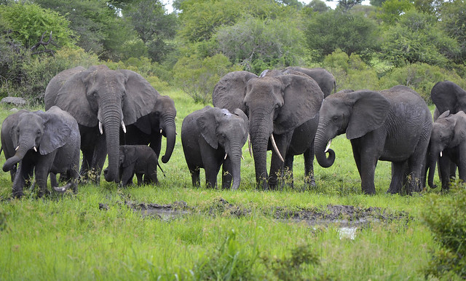
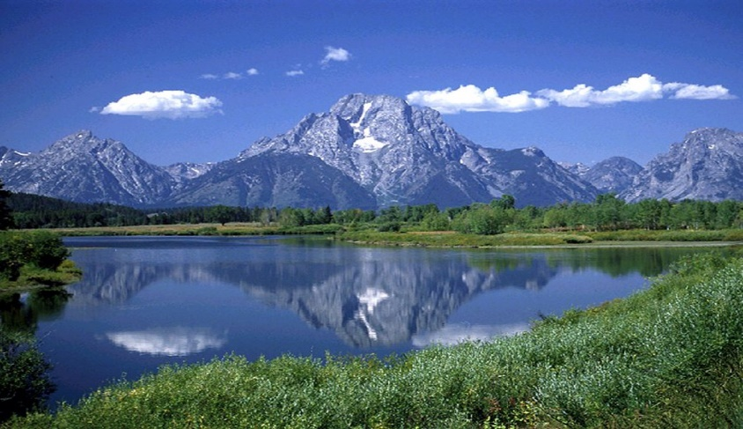
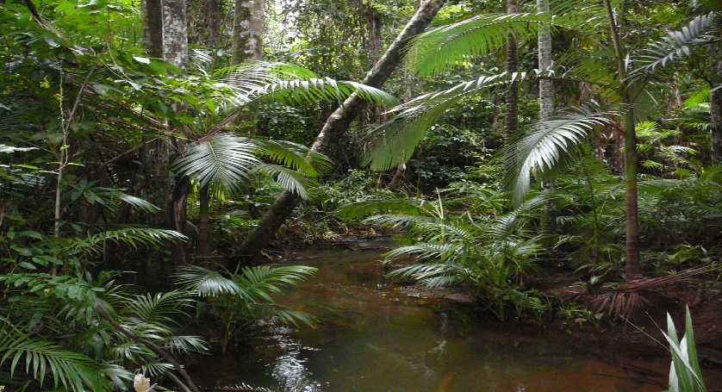
Geographers study the world by learning about the physical geography of a place.
Notes:
The physical geography of a place includes the natural and physical elements of the earth, such as:
What landforms and water features are present? How do they impact the place?
What plants and animals are present? How do they impact the place?
What is the climate and weather like? How does it impact the place?
What kind of rocks, minerals and soil are present? How do they impact the place?
What is the connection between physical systems? How do they interact with each other? How do they impact each other?
What is the connection between physical and human geography? How do they interact with each other? How do they impact each other?

Slide 7
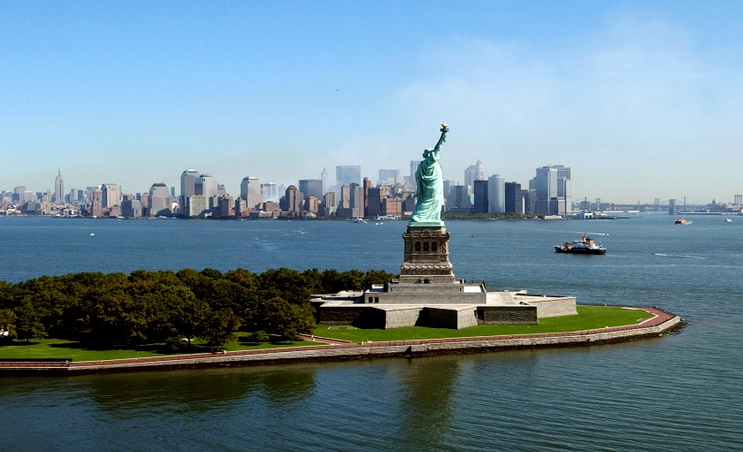
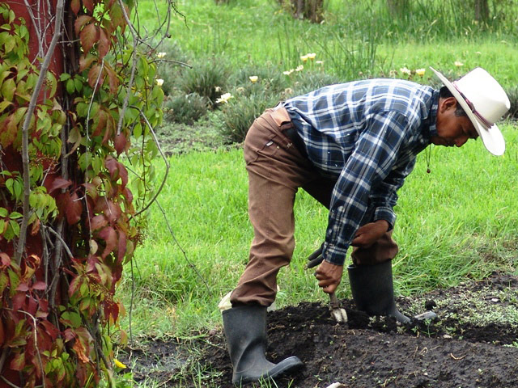
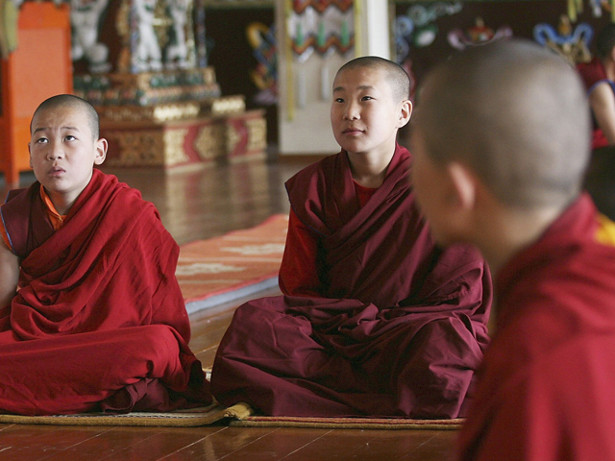
Geographers study the world by learning about the human geography of a place.
Notes:
The human geography of a place includes human characteristics, such as:
Who makes up the population of a place? Where do people live? How does that impact the place?
Where do people immigrate to and from? How does that impact a place?
What cultures are present and where are they located? (consider language, custom, religion, housing, etc.)
How do people make money and what do they spend money on?
What is city life like? What is rural life like?
What kind of government is there?
How do people get their food? What do people eat?
What natural resources do they have? How do they use the natural resources?
Where are borders and who drew them? How do they impact people inside and outside the border?
What is the connection between human systems? How do they interact with each other? How do they impact each other?
What is the connection between physical and human geography? How do they interact with each other? How do they impact each other?

Slide 8
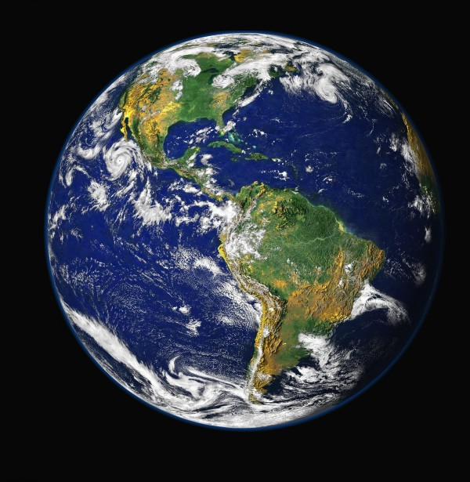
The differences between physical geography and human geography lies in the emphasis. There is no real separation.

Slide 9
Your Turn
What are the physical and human geography characteristics where you live?
How does the physical and human geography where you live interact with each other?
Notes:
For question 1: consider how physical and human geography characteristics are different depending on where you live.
For question 2: Consider not only the obvious, such as how we use mountains to hike, or oceans to swim, but also how physical geography might impact things like land value, create obstacles, or opportunities.

