Slide 1
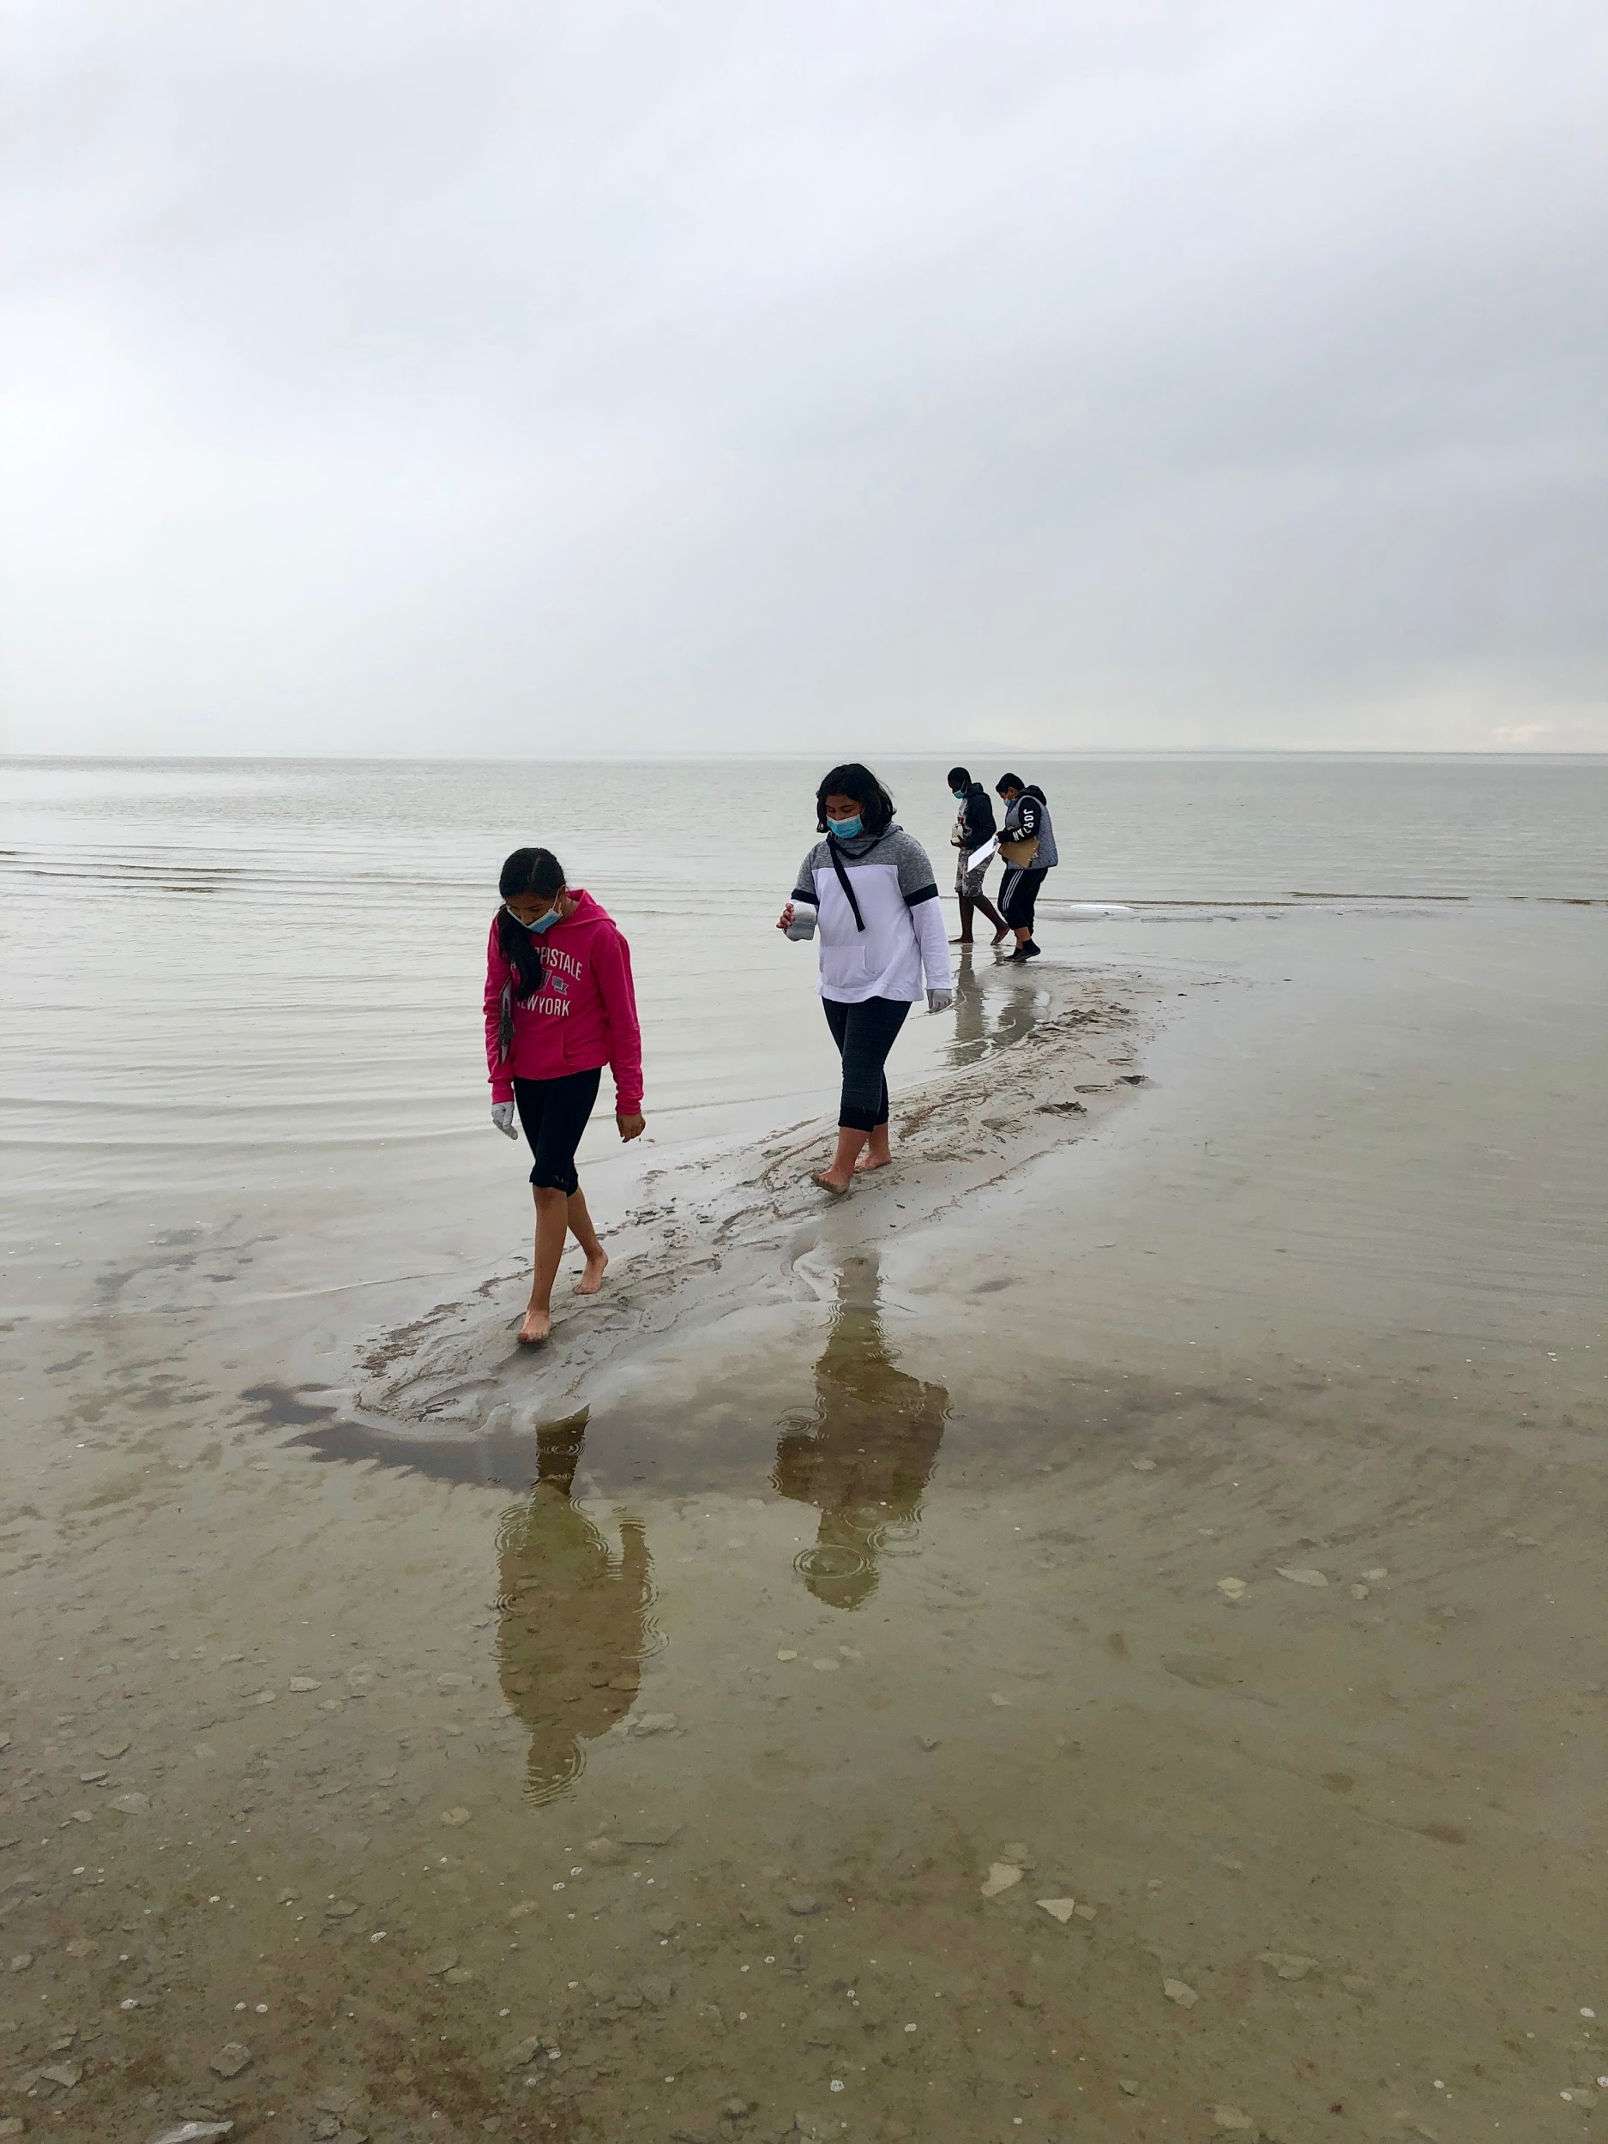
Backman Elementary School
6th Grade Team
Salt Lake City School District
Ms. Caitlin Jones
Ms. Allison Woolsey
Ms. Brianna Rolf
Mr. Matthew Gage
Mr. Dani-el Mills
2018-2019
SLCSD-NGS Grant Project 2018-2019

Slide 2
National Geographic Geo-Inquiry
Lenses, Questions, and GLS Background Information
SLCSD-NGS Grant Project 2018-2019

Slide 4
https://www.nationalgeographic.com/environment/2019/02/coal-other-dark-side-toxic-ash/
SLCSD-NGS Grant Project 2018-2019

Slide 5
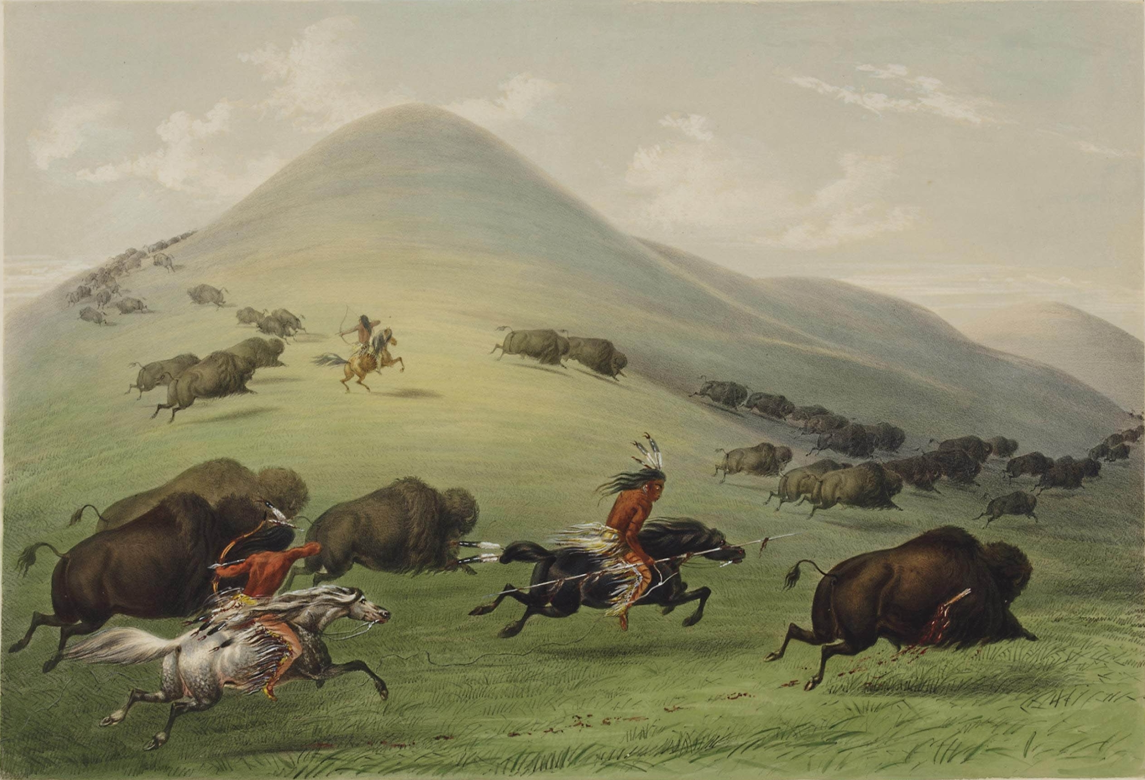
Spatial
Where something occurs is the spatial perspective.
“Where is it? Why is it there?”
Understanding spatial patterns and processes is essential to appreciating how people live on Earth. People who approach knowing and doing with a habit of inquiring about whereness possess a spatial perspective.
Real Life Example:
If I studied patterns that people do on a regular basis. Maybe I could study how the Native Americans migrated with the Bison herds. Why where those herds in that place and how did that affect life during that time.
SLCSD-NGS Grant Project 2018-2019

Slide 6
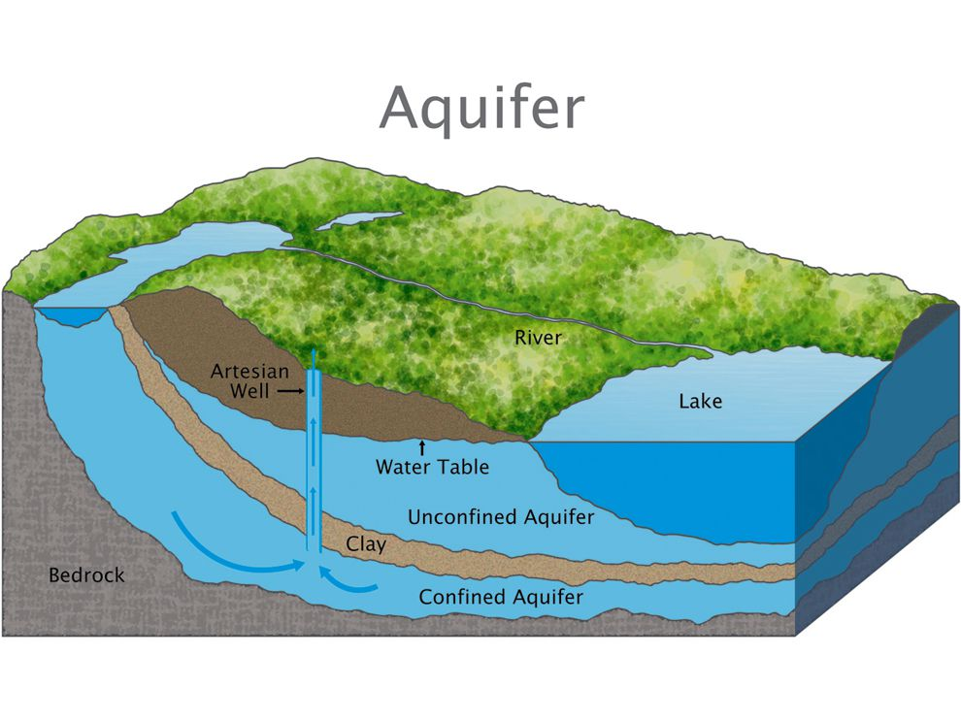
Geological
The geological lens is observing the world and looking for the “physical connections” different topics have.
Examples:
Where does our water come from?
What challenges do we have in our community due to water?
How healthy are aquifers in our community?
SLCSD-NGS Grant Project 2018-2019

Slide 7
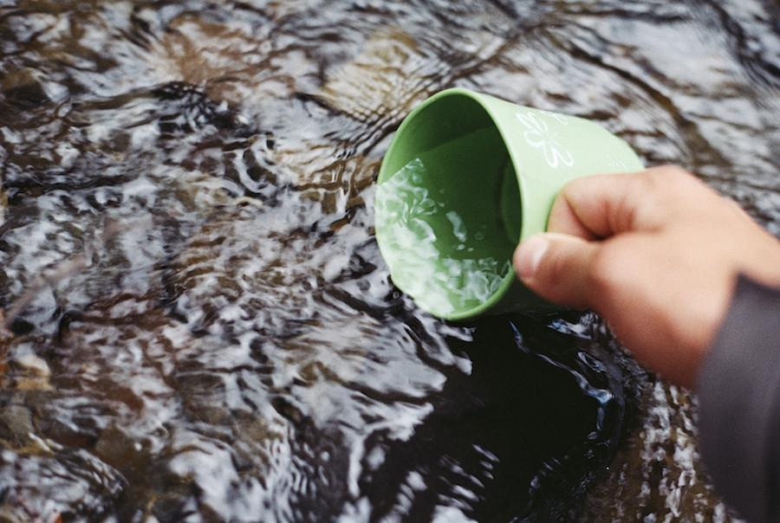
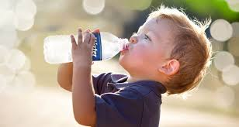
Historical
The historical lens is observing the world and looking at past events of a topic.
Examples:
How was getting water 100 years ago different from today?
When did drinking water in plastic bottles become popular and why?
How has water been valued over time?
SLCSD-NGS Grant Project 2018-2019

Slide 8
Cultural
The cultural lens is observing the world and how people interact with each other and the space around them.
Examples:
What are ways we use water?
How do we use water to enhance our neighborhoods and public spaces?
SLCSD-NGS Grant Project 2018-2019

Slide 9
Economic
Economics is the study of how humans within a society make decisions and use resources. Economics looks at the production, distribution and consumption of goods and services.
Example:
How much money does is cost to produce plastic water bottles?
Why do people buy/use things that they know are bad for the environment?
How much would it cost to clean up the great Pacific garbage patch?

Slide 10
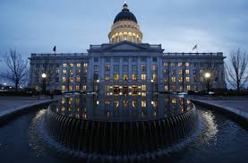
Political
The choices and decisions made by leaders of a country or other area associated with governing. (Running a country, state, or local area)
Example:
What laws are in place to support safe water usage in the Salt Lake Valley?
What can we do if we don’t agree with a law?
What issues are political groups focused on in Utah?
SLCSD-NGS Grant Project 2018-2019

Slide 11
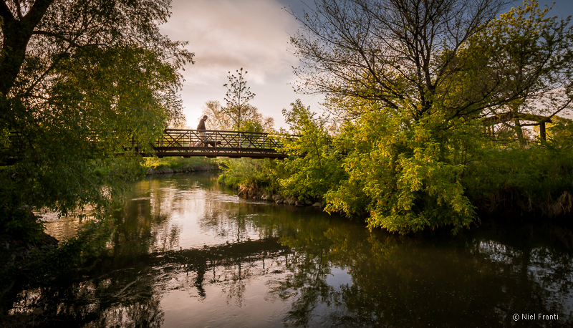
Ecological
This is the connection between humans and the environment. How are you connected with the world around you.
Examples:
How safe is the water that comes out of the tap?
How does plastic from disposable water bottles in our community affect the Jordan River?

Slide 12
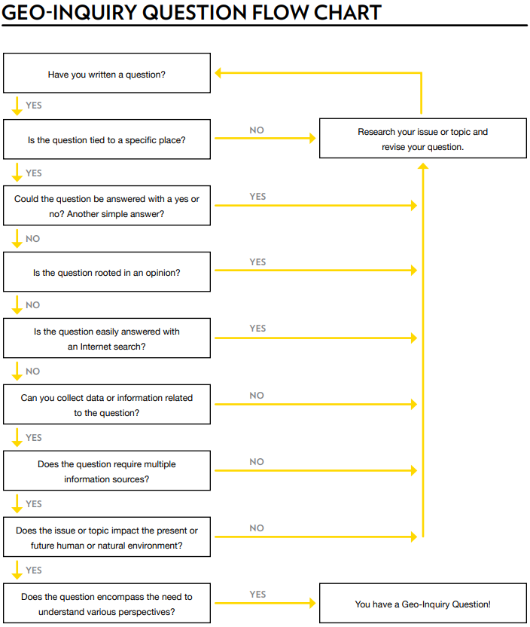
Questions Flowchart
What are the positive and negative effects of beaver dams on the silver lake ecosystem?
What did my question include? What didn’t it include? What lense does my question fall under?
SLCSD-NGS Grant Project 2018-2019

Slide 13
Silver Lake Questions
What is the main water source for silver lake?
Are there fish in the lake?
What is the elevation of silver lake?
Does the lake bring in revenue to the area?
How would the landscape change if another earthquake hit?
How do other lakes in the area compare to silver lake?
What is the surface area of the lake?
What is the depth of the lake?
How did the lake form?
Did ancient peoples use the lake for survival?
Does it hold any spiritual significance?
What extracurricular activities happen at the lake?
How long ago did the lake form?
How did the lake form?
Why is the lake there?
Was it part of a larger lake before?
How does the salinity compare to the great salt lake?
If the water level declines by half the size, how would the surrounding ecosystem be impacted?
Who does the lake attract most?
Where is the lake located?
Where is the lake deepest?
SLCSD-NGS Grant Project 2018-2019

Slide 14
Are they Geo-Inquiry?
Let’s Test Them!
SLCSD-NGS Grant Project 2018-2019

Slide 15
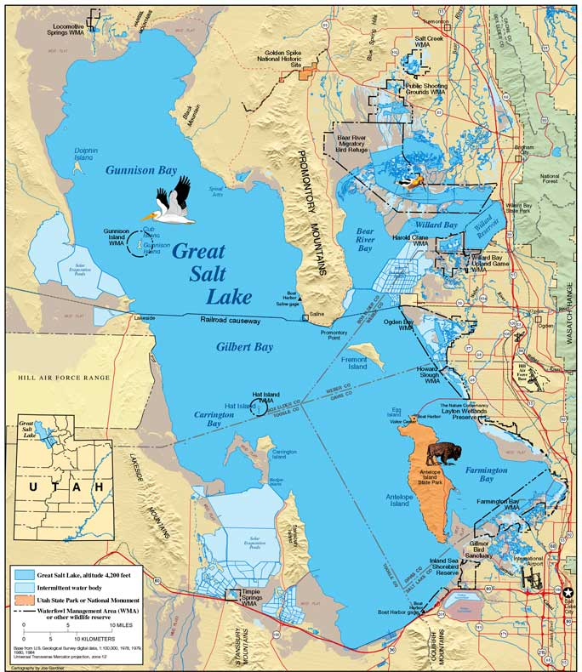
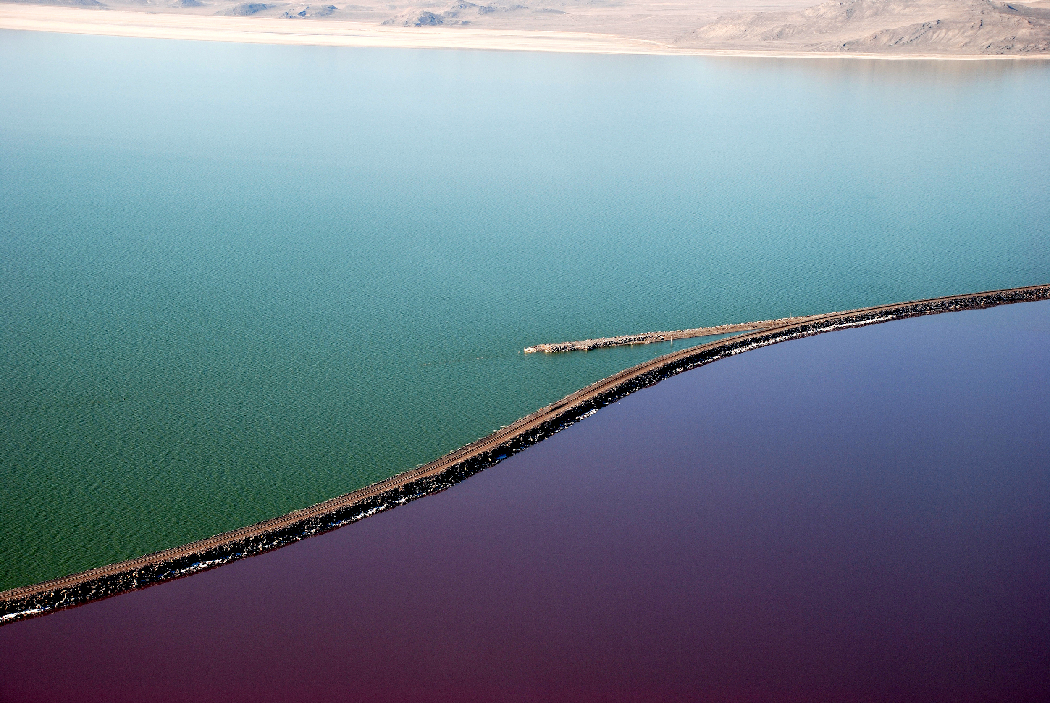
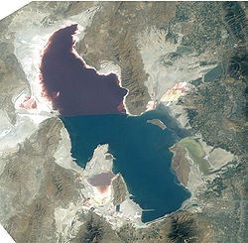
The Great Salt Lake

Slide 16
The Great Salt Lake
The Great Salt Lake is the largest saltwater lake in the Western Hemisphere and is located in Northern Utah.
It is a terminal lake, meaning that rivers do not flow out of it, only in. This adds to the saltiness of it. The three rivers that flow into it are the Jordan River, the Bear River, and the Weber River.
It is an extremely shallow lake, so the shorelines fluctuate quite rapidly.
“Although it has been called "America's Dead Sea", the lake provides habitat for millions of native birds, brine shrimp, shorebirds, and waterfowl, including the largest staging population of Wilson's phalarope in the world.” -Wikipedia
SLCSD-NGS Grant Project 2018-2019

Slide 17
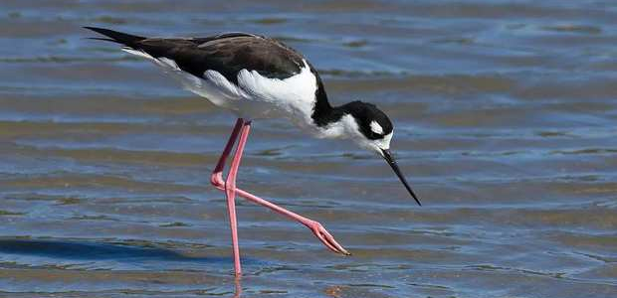
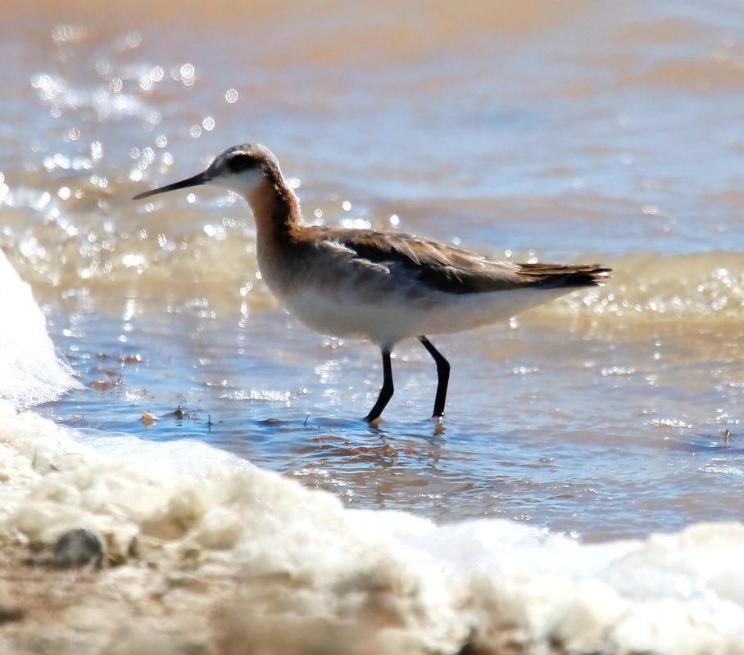
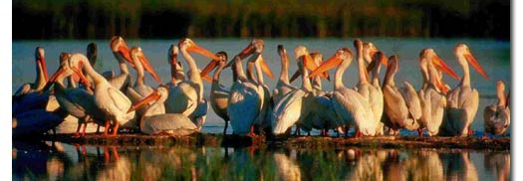
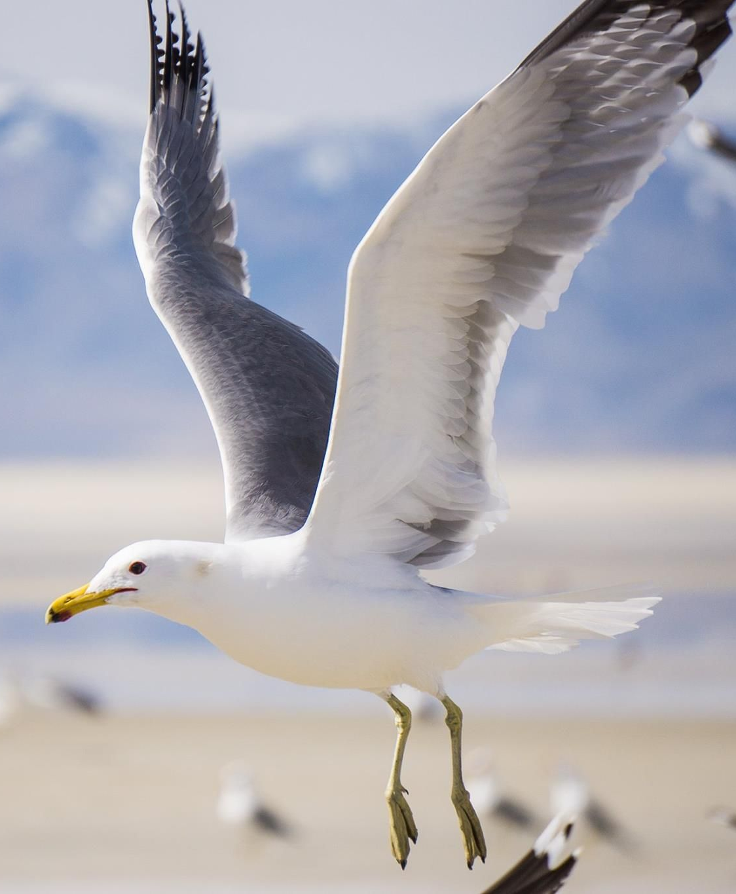
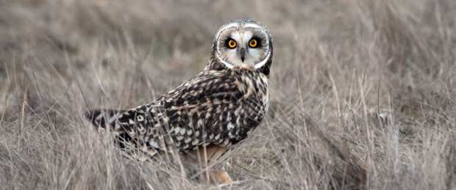
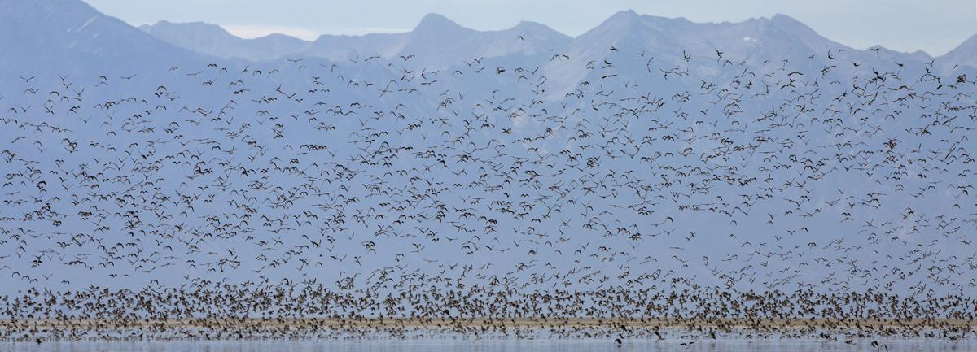
Birds
SLCSD-NGS Grant Project 2018-2019

Slide 18
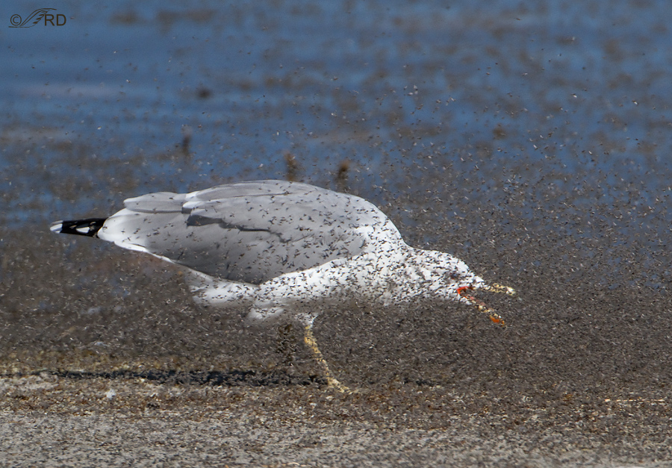
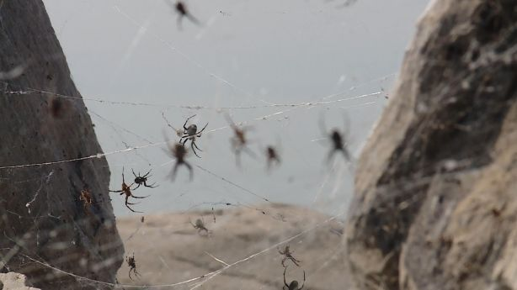
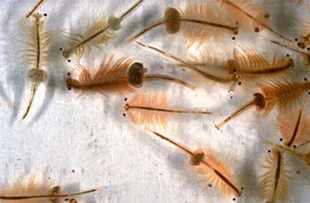
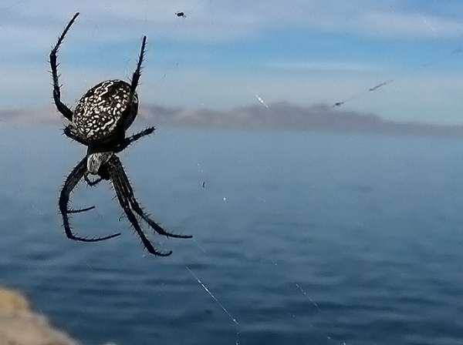
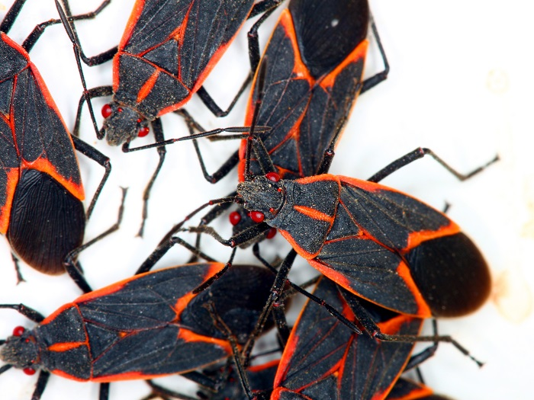
Insects, Brine, and Spiders
SLCSD-NGS Grant Project 2018-2019

Slide 19
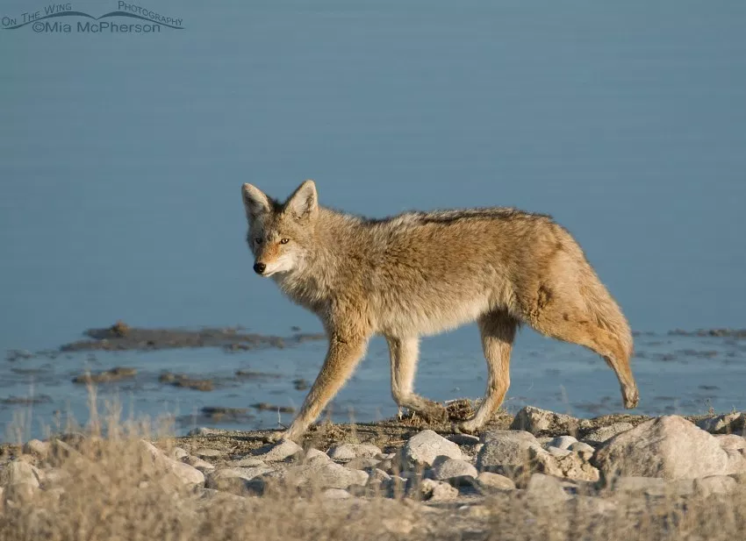
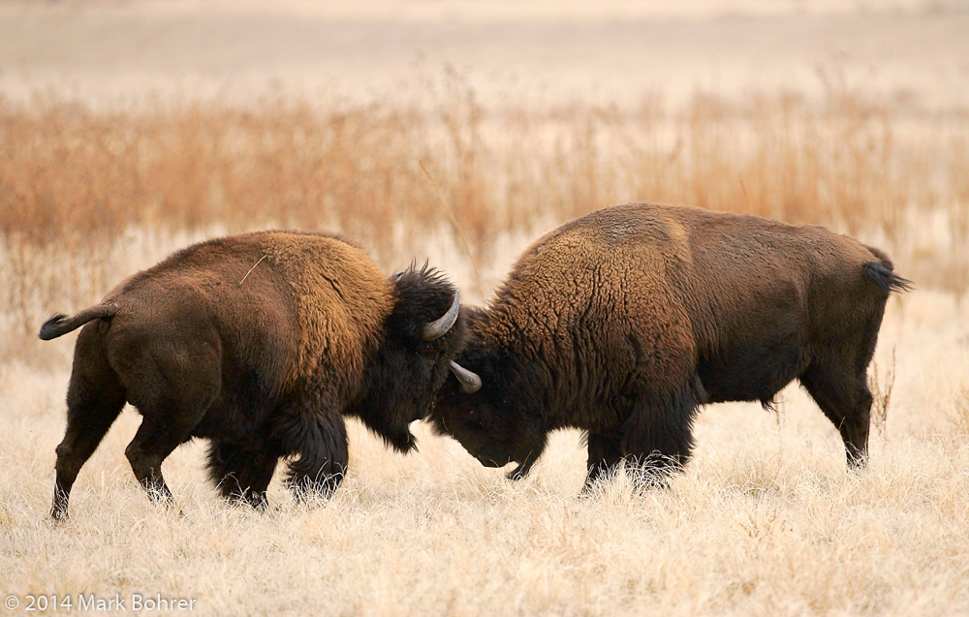
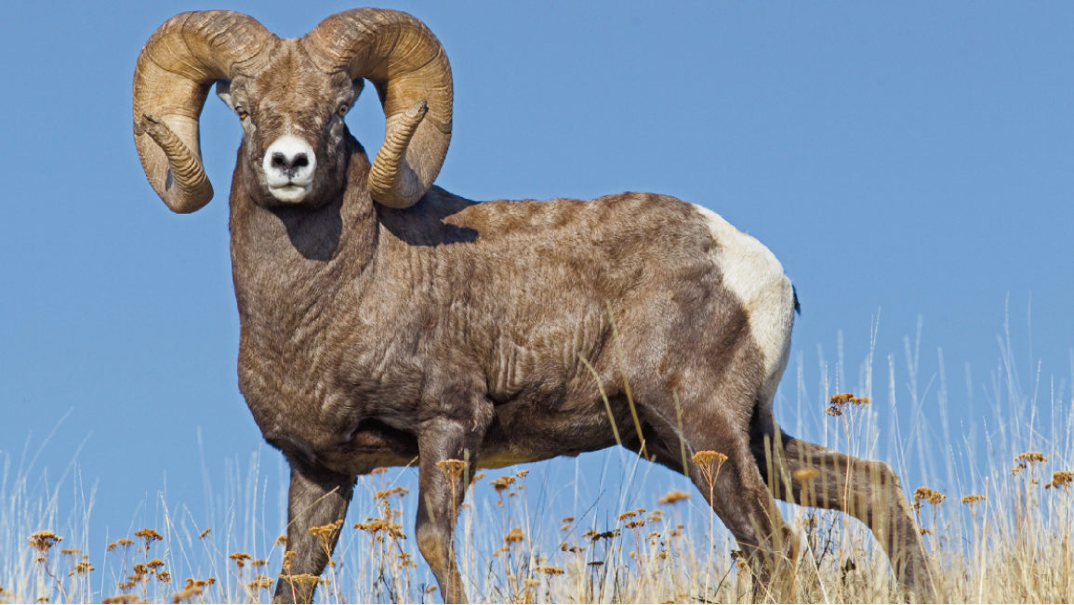
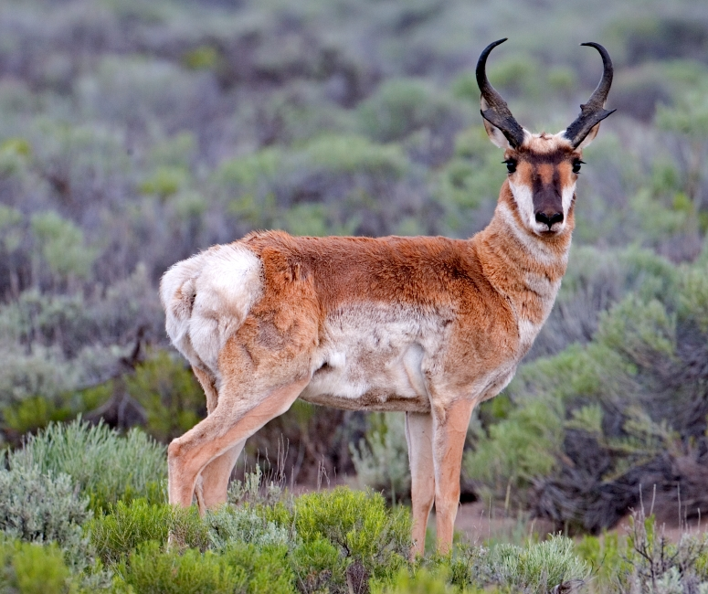
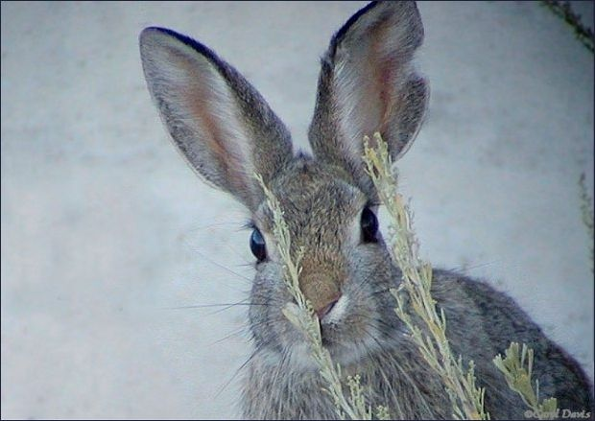
Mammals
SLCSD-NGS Grant Project 2018-2019

Slide 20
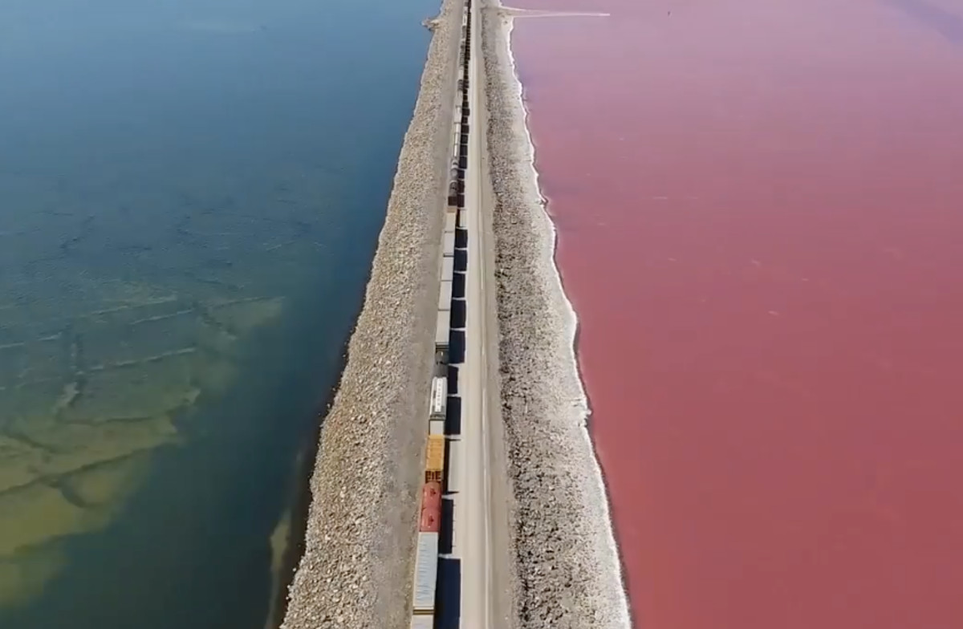
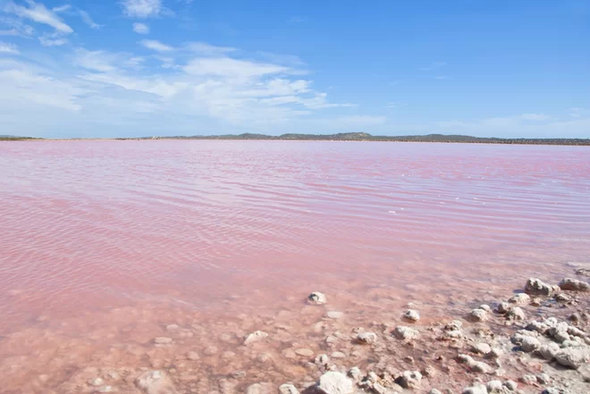
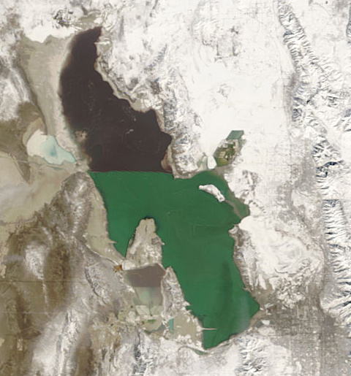
The Causeway Between the Arms
SLCSD-NGS Grant Project 2018-2019

Slide 21
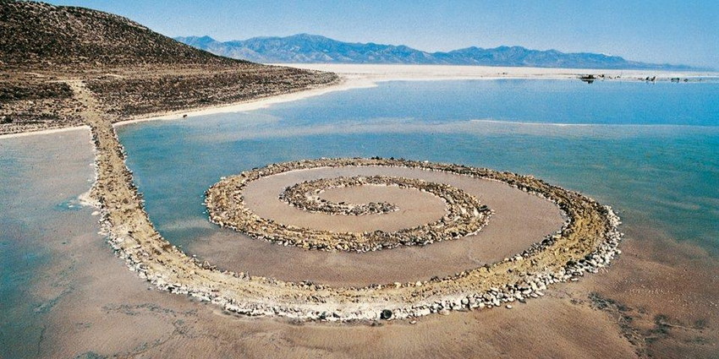
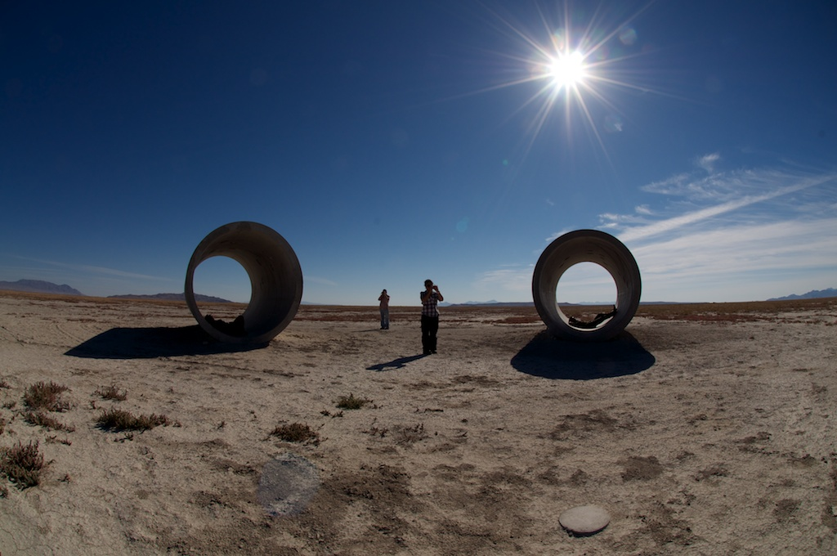
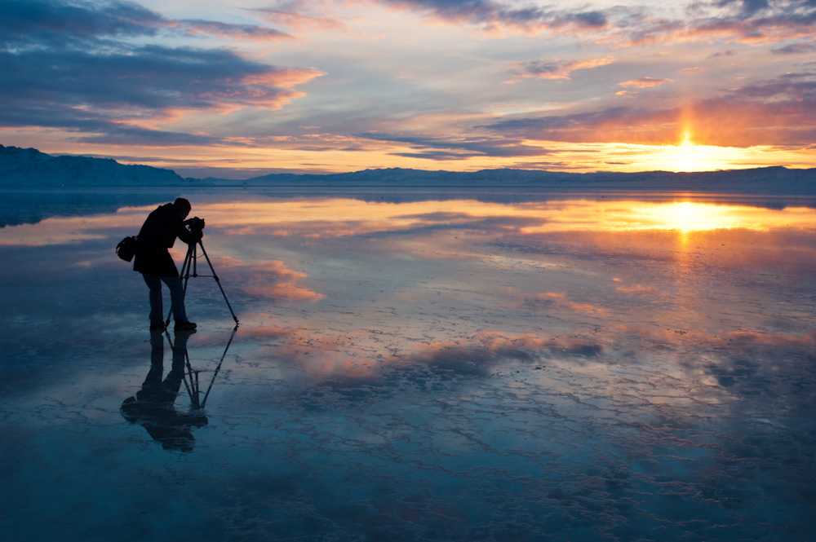
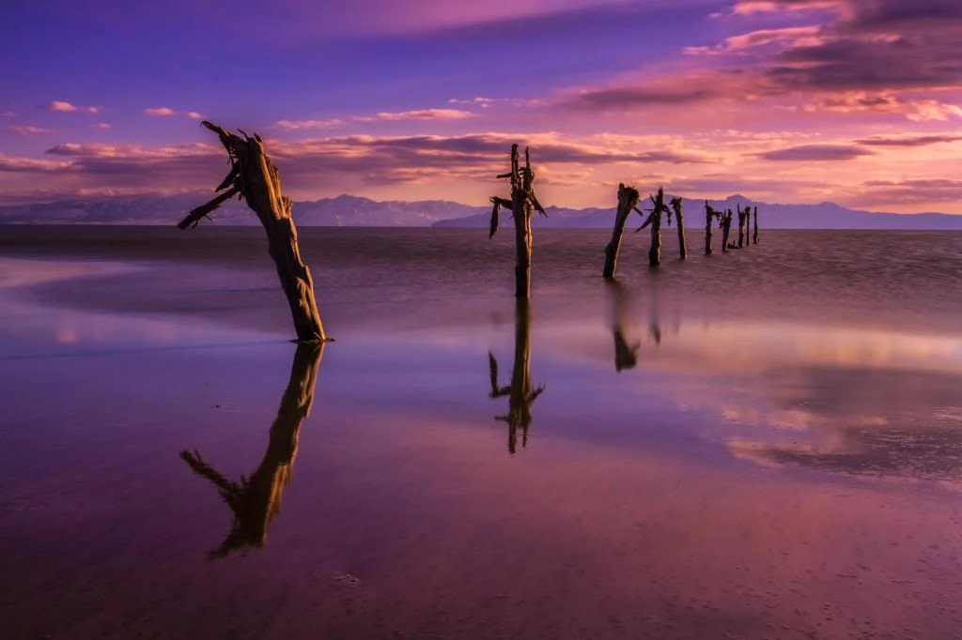
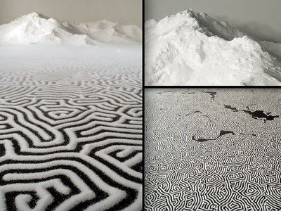
Art Inspiration
SLCSD-NGS Grant Project 2018-2019

Slide 22
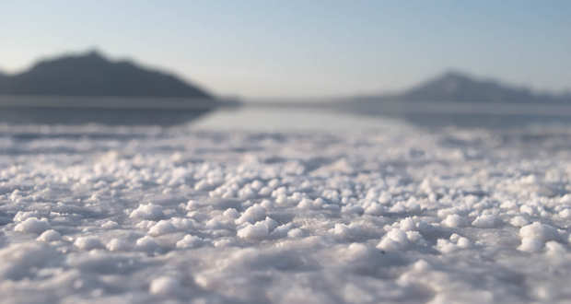
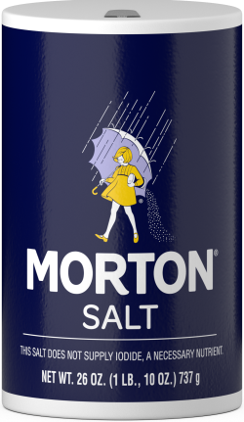
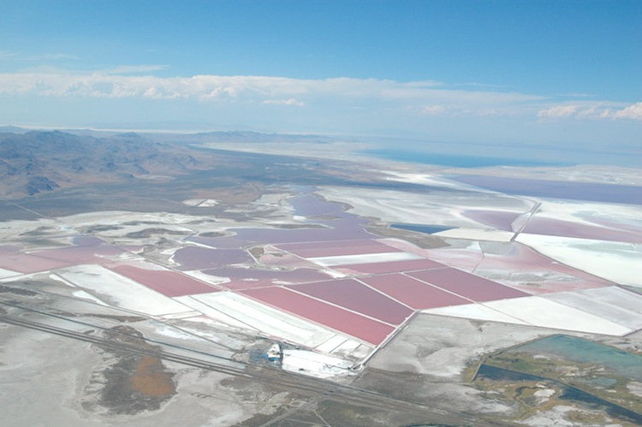
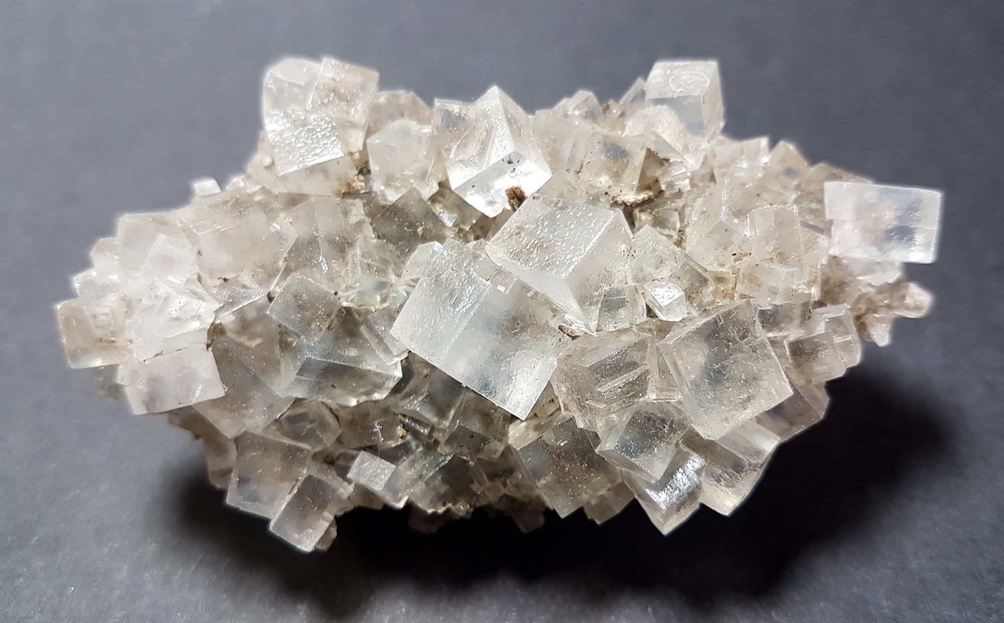
Salt
SLCSD-NGS Grant Project 2018-2019

Slide 23
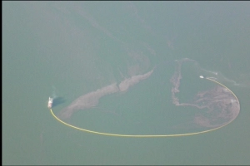
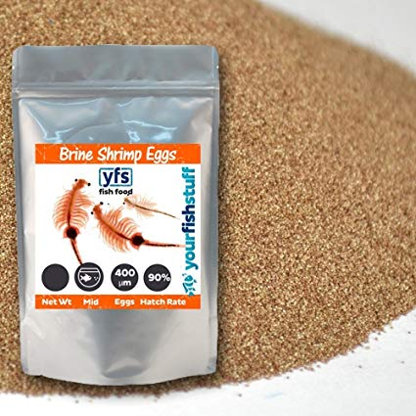
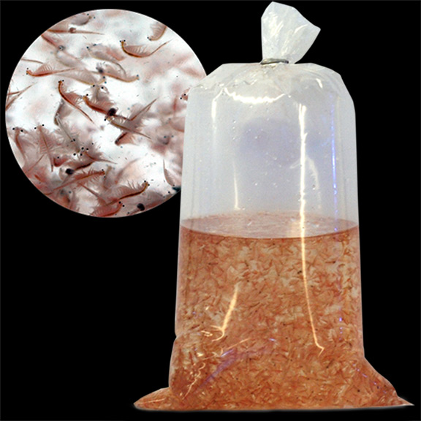
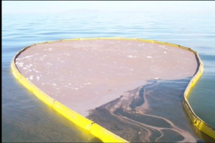
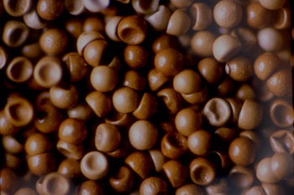
Brine Shrimp Harvesting
SLCSD-NGS Grant Project 2018-2019

Slide 24
The Great Salt Lake
The Great Salt Lake has a lot of history and fun facts that people do not know about. The slides only touched on a few things that it has to offer.
Its size, salinity, smell, density, impact on Salt Lake City, and location puzzle many people.
Come up with Geo- Inquiry questions that you can ask about the lake.
Make sure to use the flow chart.
Be Creative! The possibilities are endless!
SLCSD-NGS Grant Project 2018-2019

Slide 25
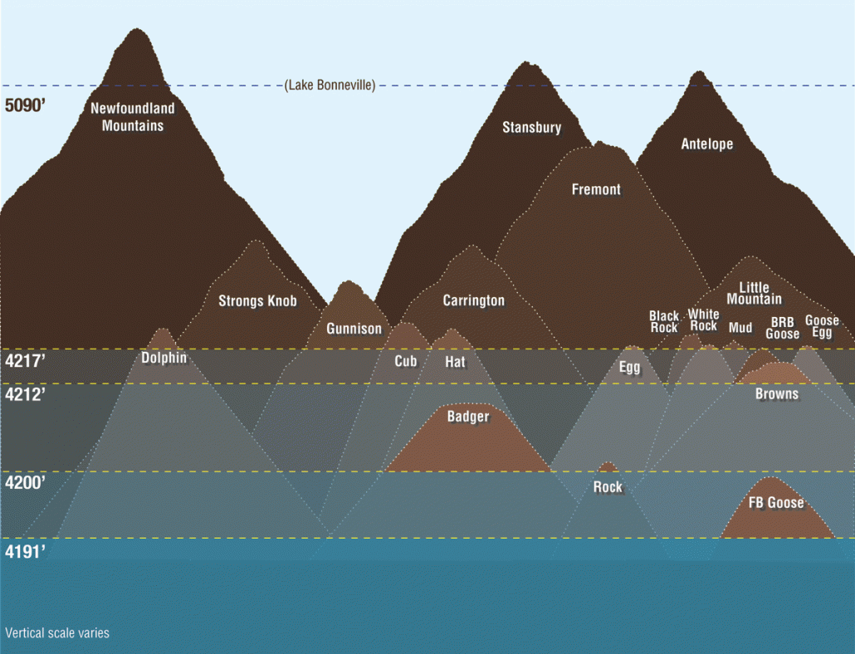
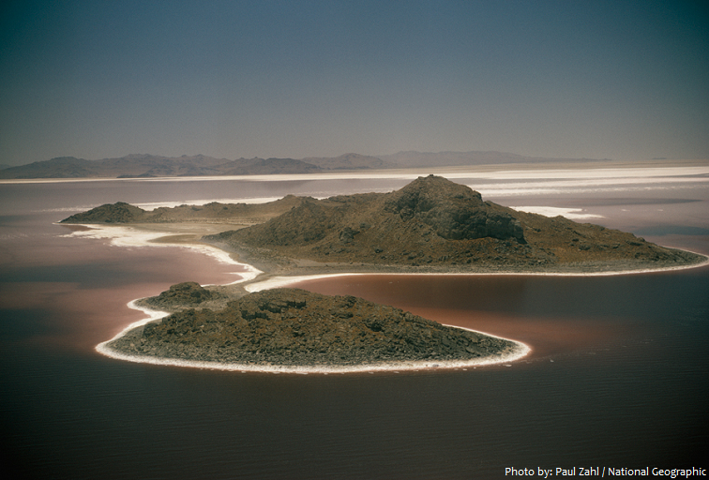
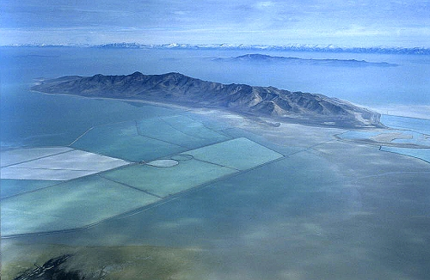
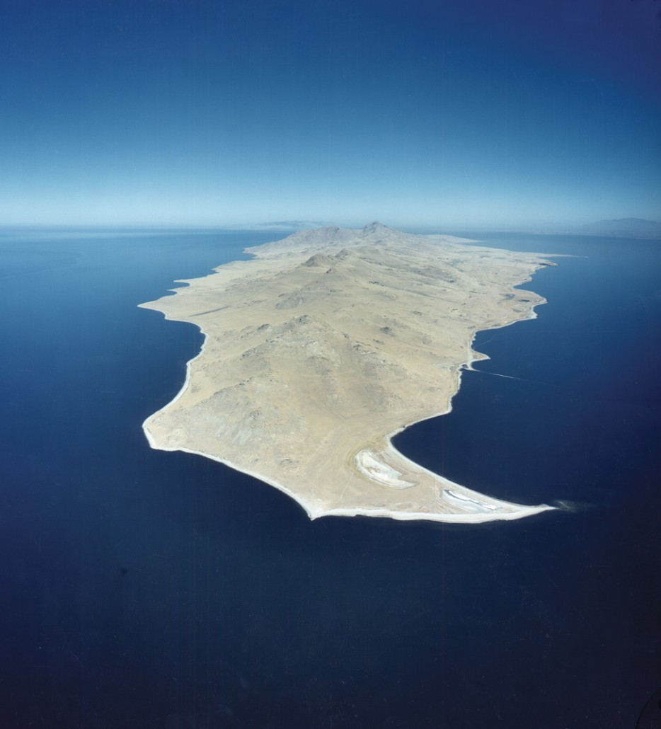
Islands
SLCSD-NGS Grant Project 2018-2019

Slide 26
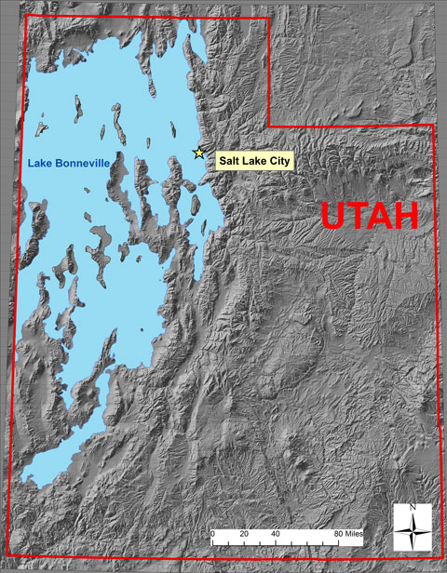
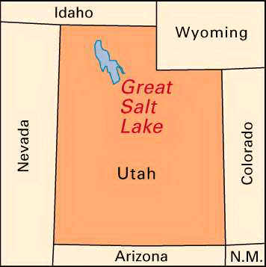
Shoreline
SLCSD-NGS Grant Project 2018-2019

Slide 27
Historical Peoples
We say peoples when we are referring to non related groups of people. The homesteaders, American Indians, and recreationalists.
SLCSD-NGS Grant Project 2018-2019

Slide 28
Break-Out Group Expectations
This is your job, not mine. I will happily help you find resources and support you with your work, but I cannot, and will not do the work for you.
This is work time, not friend time. You have been thoughtfully placed into groups. You need to work in these groups AS A TEAM!
This is a group job. You can individually build research and information, and then work as a team to create and answer your Geo-Inquiry question.
WHY are we doing this? First, this is an opportunity for you to learn how to research and work as a team. Next, this is an opportunity for you to learn more about the world around you and make connections. Last, you will build this research and project for your end of year promotion. You will be presenting it to your families. Please do this for your family!
Finally, we expect you to TRY your best!
SLCSD-NGS Grant Project 2018-2019

Slide 29
3.18.19-3.22.19
This week’s goals are:
To gain more understanding of our lense.
To gather more background information on our lense.
To start working with our teams to build a Geo-Inquiry question.
To use worksheets to organize information for our Geo-Inquiry question.
SLCSD-NGS Grant Project 2018-2019

Slide 30
Internet Research Tips and Tricks
A search engine such as google runs calculation to find information about topics you search.
Based on the words in your search you can have very specific results or general results.
If I search “What would happen to the Brine Shrimp industry if the Great Salt Lake dried up?” I will most likely get very general results.
(432,000 results) - Who wants to look through all of those?
SLCSD-NGS Grant Project 2018-2019

Slide 31
Specific Internet Search
Instead lets try and search "Brine Shrimp" And "Utah"
We HAVE to put Brine Shrimp and Utah in quotations while using “And” to tell the search engine that we want articles and information that specifically include both words/phrases.
74,000 results (Still a lot, but more focused results)
SLCSD-NGS Grant Project 2018-2019

Slide 32
Using + or -
You can also use a + to include and a - to exclude items in your internet search.
For example “utah causeway” + “Antelope Island” will find information that mentions both topics.
“utah causeway” - “Railroad” will find information about the Causeway, but exclude anything about the railroad.
SLCSD-NGS Grant Project 2018-2019

Slide 33
Ctrl + F
When looking through a text online, the easiest way to skim is clicking Ctrl+F. This will highlight any word or phrase you are searching for. The arrows next to the word will guide you to the next highlighted section.
SLCSD-NGS Grant Project 2018-2019

Slide 34
Debrief
With 5 minutes to spare in class, we will discuss the data we found today. We will next identify what we still need to be successful. Then we will create a goal for tomorrow.
Today I was able to __________________________________________________________.
I still need ____________________________________________________________________.
My group’s goal is ____________________________________________________________.
Tomorrow, my individual job will be __________________________________________.
SLCSD-NGS Grant Project 2018-2019

Slide 35
Visualize: Organizing and Analyzing Geographic Information
SLCSD-NGS Grant Project 2018-2019

Slide 36
Visualize
Visualizing data is key to telling a story. Once we’ve collected data, we need to do something about it. Visualizing our data is the next step to organizing our work and answering the Geo-Inquiry Question.
We need to first gather up and organize our data.
Next, we need to create graphs and maps that will show this data.
https://mapmaker.nationalgeographic.org/#/
SLCSD-NGS Grant Project 2018-2019

