Slide 2
We are entering Phase 1: Ask
Goal: This activity will help us learn how to ask questions.

Slide 3
View this video
https://www.youtube.com/watch?v=kxU9ftFZJzQ

Slide 4
Journal: 5 Minute Quickwrite in your notebook
Only a free individual can make a discovery.
- Albert Einstein

Slide 5
Questions? Concerns?

Slide 6
The Question Formulation Technique (QFT)
www.rightquestion.org

Slide 7
"There is no learning without having to pose a question."
- Richard Feynman
Nobel-Prizewinning physicist
Notes:
DAN

Slide 8
College Presidents on What Students Should Learn in College
“The primary skills should be analytical skills of interpretation and inquiry. In other words, know how to frame a question.”
- Leon Botstein, President of Bard College
“…the best we can do for students is have them ask the right questions.”
- Nancy Cantor, Chancellor of University of Illinois
The New York Times, August 4, 2002
Notes:
DAN

Slide 9
Yet…only 27%of students believe college taught them to ask their own questions
Alison Head, Project Information Literacy at University of Washington, 2016
Notes:
DAN

Slide 10
Percentage of Basic Skill Attainment
Sources
http://nces.ed.gov/nationsreportcard/pdf/main2009/2011455.pdf
http://nces.ed.gov/nationsreportcard/pubs/main2007/2008468.asp#section1
Data on question-asking based on parent and teacher feedback
Notes:
DAN

Slide 11
In your notebook, write down these
Rules for Producing Questions
ASK as many questions as you can.
Do not stop to discuss, judge or answer the questions.
Write down every question exactly as it is stated.
Change any statement into a question.

Slide 12
What might be difficult about following these rules?

Slide 13
Let’s try asking questions…
On the next slide, you will find a prompt.
Following the rules for producing questions, ask questions about the prompt

Slide 14
Prompt:
My classmates are not asking questions.
Follow the Rules for Producing Questions.
Number your questions.

Slide 15
Improve Your Questions
You might have these two kinds of questions in your list:
Closed-ended questions – they can be answered with “yes” or “no” or with one word.
Open-ended questions – they require an explanation and cannot be answered with yes” or “no” or with one word.

Slide 16
Improve Your Questions
Identify closed- and open-ended questions.
Mark the closed-ended questions with a C and the open-ended questions with an O.

Slide 17
Improve Your Questions
2. Name advantages of asking closed-ended questions.
3. Name disadvantages of asking closed-ended questions.
4. Name advantages of asking open-ended questions.
5. Name disadvantages of asking open-ended questions.

Slide 18
Improve Your Questions
6. Review your list of questions and change one closed-ended question into an open-ended.
Then, change one open-ended question into a closed-ended one.

Slide 19
Prioritize Your Questions
Choose three questions that you consider most important.
Keep in mind the Question Focus.
Mark each priority question with an “X”

Slide 20
Share Your Questions with the class
Please share:
The questions you changed from closed to open-ended and from open-ended to closed. Read each question as originally written and how it was changed
Your three priority questions
Your rationale for selecting those three
The numbers of your priority questions

Slide 21
Reflection
What did you learn?

Slide 22
Let’s practice asking questions about Geography. Follow the Rules for Producing Questions & ask questions about the photo on the next slide.

Slide 23
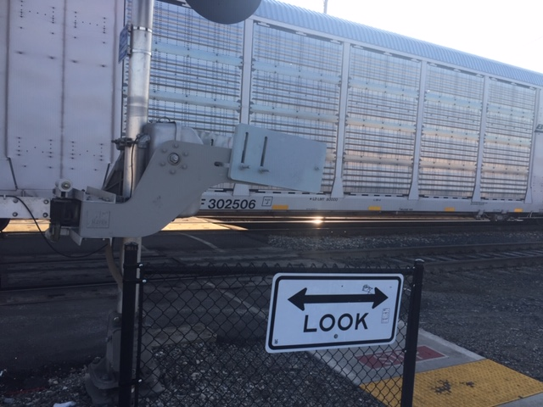

Slide 24
