Slide 1
Geography 3B
National Geo graphic Geo Inquiry Process
Ms. Arthur
West High School
Salt Lake City School District

Slide 2
2 Column (Cornell) notes
Thinking: Questions, Connections, Reflections
Notes: Ideas from the lecture / PowerPoint

Slide 3
Turn & Talk: What do you know about National geographic?

Slide 4
National Geographic GeoInquiry
GeoInquiry is a way of asking questions about the world to create positive changes.
National Geographic explorers use it and now students do, too.

Slide 5
We are a GeoInquiry classroom… like this one

Slide 6
Writing Time
Thinking: Questions, Connections, Reflections
Notes: Ideas from the lecture / PowerPoint

Slide 7
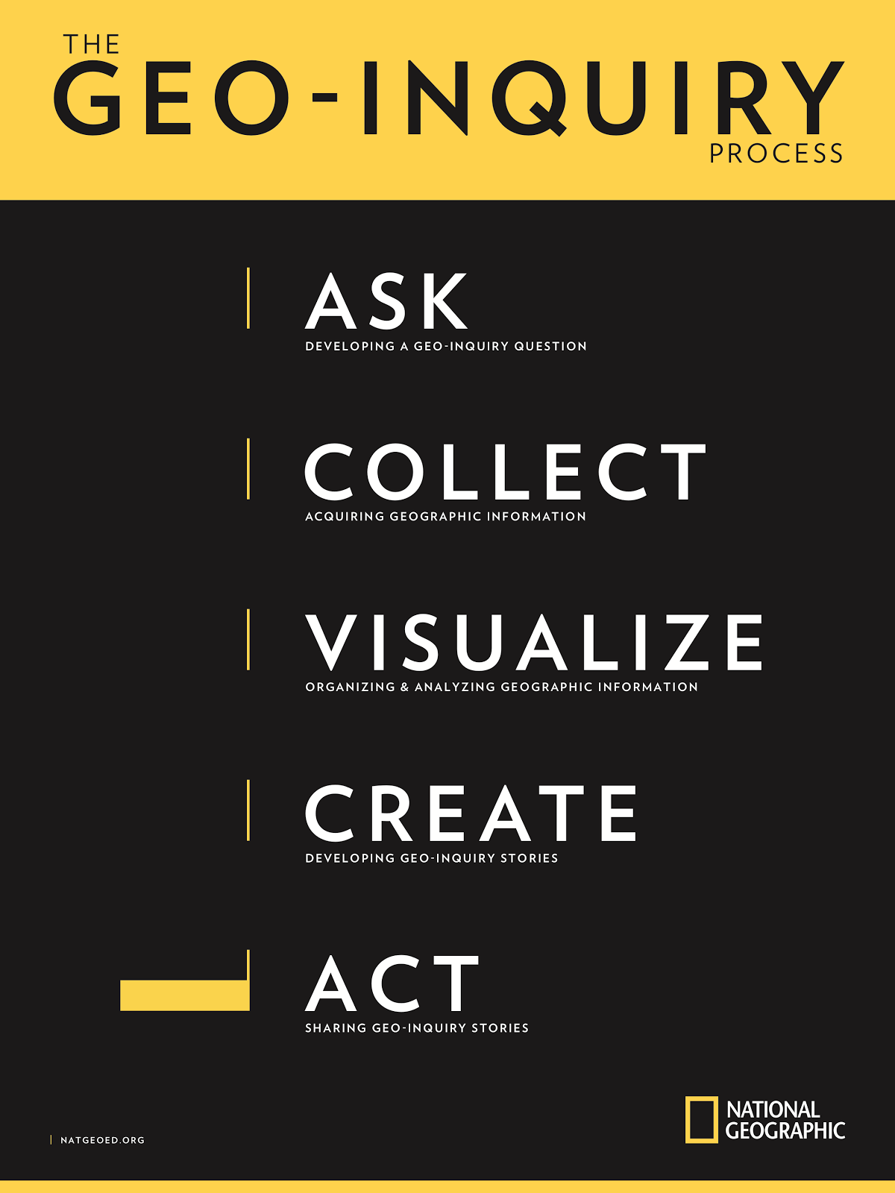

Slide 8
Ask- Developing a GeoInquiry Question
Collect- Acquiring Geographic Information
Visualize- Organizing & Analyzing Geographic Information
Create- Developing Geo-Inquiry Stories
Act- Sharing GeoInquiry Stories

Slide 9
Writing Time
Thinking: Questions, Connections, Reflections
Notes: Ideas from the lecture / PowerPoint
How do National Geographic explorers apply the GeoInquiry process?
Give examples from the video
Ask
Collect
Visualize
Create
Act

Slide 10
How a New Generation Is Saving Zambia's Lions | National Geographic
https://www.youtube.com/watch?v=gBftNUSecpc

Slide 11
Writing Time
Thinking: Questions, Connections, Reflections
Notes: Ideas from the lecture / PowerPoint
How do classrooms apply the GeoInquiry process?
Give examples from the video
Ask
Collect
Visualize
Create
Act

Slide 12
Geo-Inquiry: Skip the Bag, Save the Sea
https://www.youtube.com/watch?v=5mv73n-I5do

Slide 13
Our Topic
How do physical obstacles affect our ability to get to school?
How does our ability to get to school affect our achievement?

