Slide 1

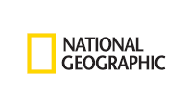
Welcome
National Geographic
Geo-Inquiry Cohort!
December 10, 2018
Chris Hines, National Geographic
Adam Dastrup, Salt Lake Community College
Merinda Davis, Alpine School District
Dessie Olson, Salt Lake City School District

Slide 2

Today’s Outcomes
Address questions & concerns
Review Frontloading, Scaffolding, & Differentiation
Collaborate to complete template
Plan technology
Identifying professional needs

Slide 3
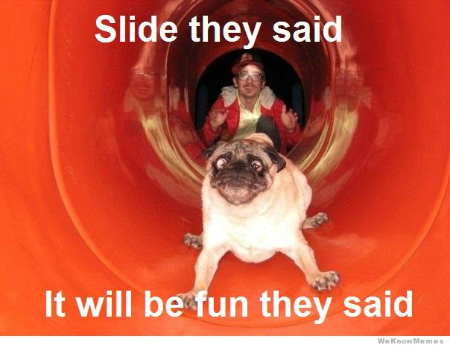
Questions & Concerns
Notes:
http://weknowmemes.com/2013/08/25-funny-dog-memes/

Slide 4

A Thought…
“I never teach my pupils, I only attempt to provide the conditions in which they can learn.”
― Albert Einstein
Notes:
The fun part of teaching, I think, is planning learning experiences and instructions. This is where we get to be the most creative and think about who our students are a learners, so we can “provide the conditions in which they can learn”. It’s the most creative part and can be a lot of fun.

Slide 5
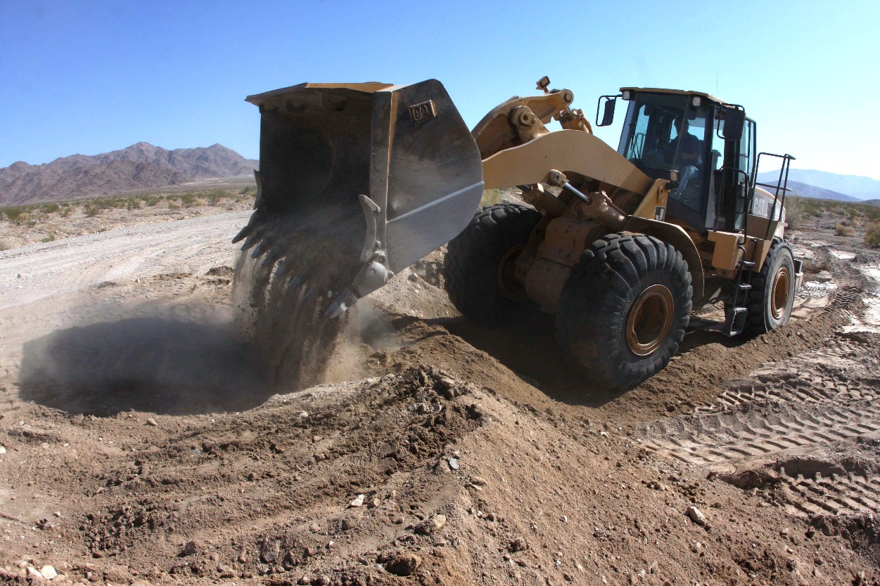
Frontloading
Jeff Wilhelm states:
Frontloading is the most important thing you can do to insure student success. Research suggests that well over half of student comprehension problems can be eliminated if teachers activate background knowledge students already possess prior to reading.
Build from pre-existing interests and capacities to the development of new ones
Notes:
The first context for planning learning experiences we’ll discuss is Frontloading.
Frontloading is a strategy you use intentionally and it does several things:
It can act as a hook/create interest
Activate background knowledge; It can identify where your students are (starting point)
Builds background knowledge; It can lay the foundation on which to build learning
Create interest
How did I frontload our lesson on Assessment? What did I do? What did you do? (asked what acceptable evidence is, reviewed teaching standards on assessment, etc.)
Frontloading doesn’t just happen once, it can be process in and of itself, but it is an important thing to consider when planning your instruction and learning experiences.

Slide 6
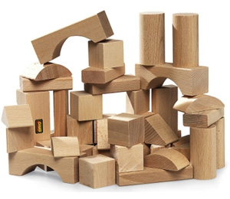
Scaffolding
Building blocks that help to build solid knowledge/skill structures
Providing supports where needed along the process of learning
Gradually removed
Includes differentiation
Notes:
http://www.cmu.edu/teaching/solveproblem/strat-criticalthinking/criticalthinking-07.html
Another important concept to think about while planning your instruction and learning experiences is scaffolding.
Review slide.
Just as construction workers use supports or scaffolding to help in building physical structures, so does "instructional scaffolding" help students build solid knowledge or skill structures. Instructional scaffolding refers to the process by which instructors provide students with cognitive supports early in their learning, and then gradually remove the support as students develop greater mastery and sophistication.
Keep in mind, scaffolding doesn’t just apply to knowledge, but skills as well. Scaffolding refers to providing students stepping stones toward being able to accomplish a task or acquire knowledge successfully.

Slide 7

What does scaffolding look like in the classroom?
Breaking down complex content/skills into manageable/logical chunks
Sequence skills so that they build on each other
Progress into complexity
Provide demonstrations and analogies
Provide support such as sentence frames, check lists, reminders, etc.
Starting points, hooks, and frontloading are part of scaffolding
SIMPLE COMPLEX
Notes:
Little information/skill to More information/skill

Slide 8

What is Differentiation?
How we structure instruction and learning activities to meet the differing abilities of students in the same class
Intent is to support each student to be successful, while providing them the kind of support structures/scaffolding they need
Consider: varying background knowledge/experiences, level of readiness, language, learning styles, and interests
Notes:
Whole group…
Differentiation is another important concept to consider when planning your instruction and student learning experiences. How would you describe what differentiation is? Either type in how you would describe it or type in a ? if you have no clue whatsoever.
Phase in descriptions of what differentiation is and review the slide.

Slide 9
The standard is not negotiable, but the road to it is.
Notes:
Whole group…
Differentiation is another important concept to consider when planning your instruction and student learning experiences. How would you describe what differentiation is? Either type in how you would describe it or type in a ? if you have no clue whatsoever.
Phase in descriptions of what differentiation is and review the slide.

Slide 10
How can we differentiate & for whom?
Content – what is taught
Process – How it’s taught
Product – How can students demonstrate what they learned?
EVERYONE
Notes:
Discussion:
Have you ever found yourself in a situation where you needed an adaptation, accommodation, or extra support of some sort? For example, do you where glasses/contacts? Have you ever had someone sit in front of you in a movie theatre who blocked your view? What about dietary accommodations?
Just like there are accommodations we embrace/need in every day life, so too are there ways we can provide differentiation/accommodations to students based on their needs.
Review the slide.
For example, perhaps you have a students who is terrified of talking in front of people but you had an assignment that requires students to present to the class. How could you differentiate for that student? Is this differentiating content, process, or product?
What if you had a student who was severely behind other student in their reading abilities. How could you differentiate something you want students to read? Is this differentiating content, process, or product?
What if that same student, who struggles to read, is always participating in class discussions, asks thoughtful questions, learns quickly when you show them how to do something, and clearly shows they understand what you’re teaching when you ask him/her to discuss it, but the final exam is in a written format. How could you differentiate the final exam for this student? Is this differentiating content, process, or product?

Slide 11
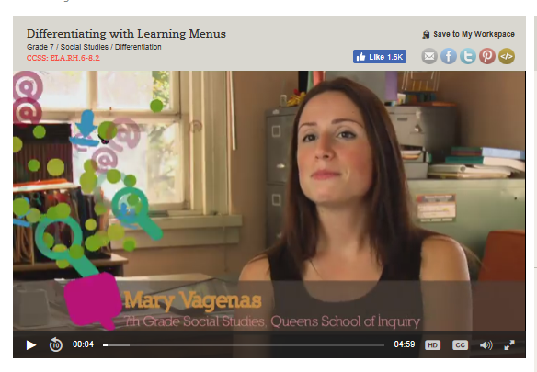
Notes:
https://www.teachingchannel.org/videos/differentiating-instruction-strategy
This video can serve as an example for how to differentiate assignments and roles during the Geo-Inquiry process.

Slide 12
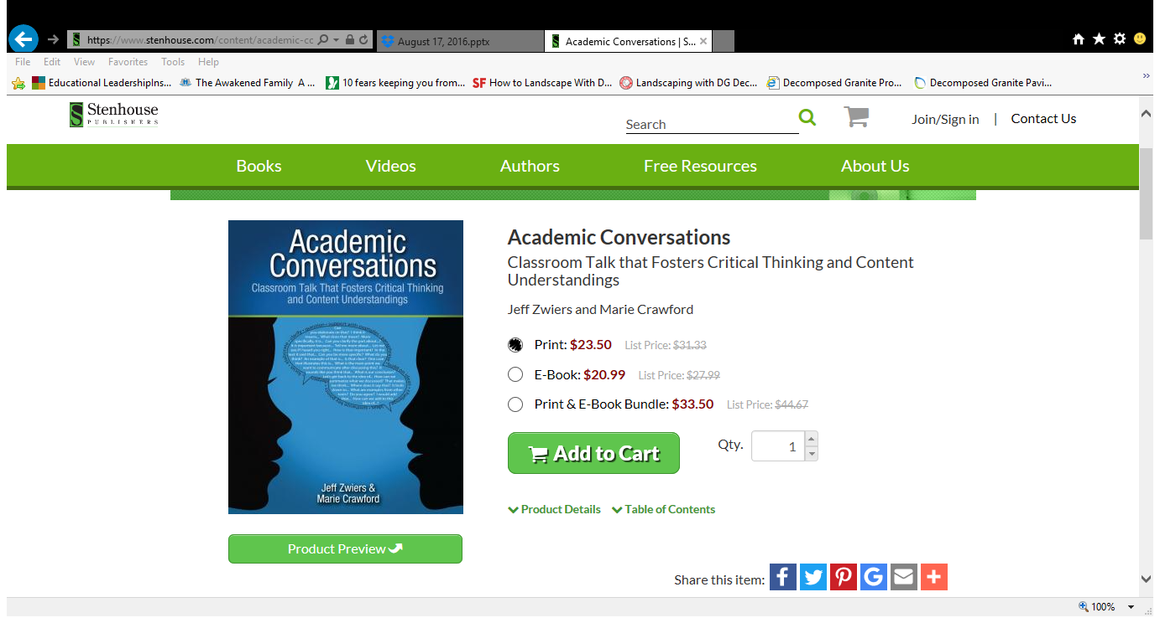
A Discussion Strategy:
Academic Conversations:
Notes:
How do student academic conversations typically go in your classroom?
This book provides strategies for helping students engage in academic conversations by providing sentence starts.

Slide 13
To what degree is this an example of an academic conversation?
  Prompt: Discuss with your partner an important thing that happened during the Westward Expansion.
      Student A: immigrants moved to new land
      Students B: Indians lived there
      Student A: they traveled a long time
      Student B: many people killed
      Student A: the U.S. was bigger
      Student B: yeah....
Notes:
Discuss as a whole group.

Slide 14

The Challenge
Most learners don’t walk into our classrooms with the tools necessary to engage in purposeful, academic conversations with their peers
We must explicitly teach these skills

Slide 15

Student Discussions &
Academic Conversations
“Discourse in the classroom is less than 2 minutes an hour and even less for struggling students.”
Wilhelm and Smith, 2012
Notes:
Oh, Yeah! Putting Argument to Work Both in School and Out, Wilhelm and Smith

Slide 16
Student Talk vs. Teacher Talk from the book, Academic Conversations
ACADEMIC CONVERSATIONS | TRADITIONAL CLASS DISCUSSIONS
97% student talk | 97% teacher talk
Average student response – 8-12 seconds | Average student response – 2-3 seconds
No teacher approval or disapproval | Teacher judgment; emphasis on correctness
Thinking is paramount, backed up with textual evidence | Rightness is paramount; thinking ends when someone is right
Students listen primarily to peers | Students listen primarily to teacher
Student ownership for “flow” | Teacher ownership for “flow”
Notes:
Take a look at this data comparing the traditional format for teacher led classes and discussions vs. teacher facilitating student conversation.???
Think of the teachers in your school – which do you see as academic v. traditional

Slide 17
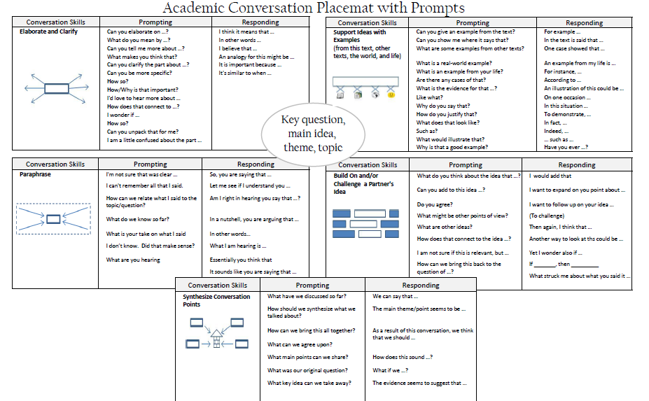
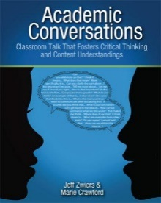
Discourse Placemat – Let’s Practice
Practice with something familiar - Should soda be sold in school vending machines?
Scaffold!
Practice with one section at a time.
Notes:
Provide teachers a reading of something they can all relate to. Select one section of the Academic Placemat and ask teachers to engage in a conversation using those sentence starters. Then debrief the experience.

Slide 18
Discourse Placemat – Debrief
How did using deliberate sentence frames impact you as you participated in this discussion?

Slide 19
Getting started with Academic Conversations
Set the expectation at the start of the school year
Discuss what a conversation is/is not
  Many students may believe that the goal of a conversation is to win an argument
Set norms for conversations
Teach skills explicitly and practice, practice, practice
Notes:
Set your students up for success by thinking about these things. Remind teachers that it takes time for students to become comfortable to engage in academic conversations. Encourage teachers to use the strategy little by little throughout the year. The book, Academic Conversations, has other practical suggestions.

Slide 20
Conversation Norms ideas…
We listen to each other
We share our own ideas and explain them
We respect another’s ideas, even if they are different
We respectfully disagree and try to see the other view
We let others finish explaining an idea without interrupting
We try to come to some agreement in the end
We take turns and share air time
Remember…
DISCUSS conversations with your students. What is expected of them?
Model GOOD and BAD conversations.
Emphasize and teach the habit of staying on topic, on target.
Establish norms as a class over time, post in the room.

Slide 21
What do students say?
“I didn’t know what I knew until I talked about it”
“Conservations not only made us sound smarter, I think they actually made us smarter.”
“Science wasn’t very interesting until we started talking about it.”
“We were still talking about history when class was over!”
Notes:
We use language to represent our thinking
Producing language through speaking or writing helps us both process and retain information

Slide 22


Slide 23

Your Turn
Read and discuss the feedback you received from NGS online cohort
Collaborate to complete your template
  Use the checklist to help you think through gaps that may exist
  Collaborate with technology experts
  Keep track of yours and student needs
  Write questions on the chart
3. What pre and post survey will we use? Should we develop one for all of us or do you want to design your own?

Slide 24

Next Steps
Watch for online course certificate/send me a copy
Implement Geo-Inquiry plan
  Send me your start and end date
  Document through pictures or videos (no faces), projects
  Stay in touch with our cohort
4. Revise and Finalize template for submission to Canvas
  CELEBRATE!!!

